Slide 1
ROUGH SET THEORY- FUNDAMENTALS
Jaya Sil
Department of Computer Science and Technology
Indian Institute of Engineering Science and Technology, Shibpur
Howrah-711103
js@cs.iiests.ac.in
Notes:
1

Slide 2
Introduction
Rough set theory proposes a new mathematical approach to imperfect knowledge, i.e. to vagueness or imprecision.
There are many approaches to the problem of how to understand and manipulate imperfect knowledge.
The most successful approach is based on the fuzzy set notion proposed by L. Zadeh in the article Fuzzy sets, Information and Control, 8, 338-353, 1965.
In Rough set based approach, vagueness is expressed by a boundary region of a set, i.e. formulate sets with imprecise boundaries.

Slide 3
Introduction
Rough set theory (RST) overlaps with Fuzzy set theory and many others dealing with uncertainty
An independent, complementary but not competing discipline
RST handles vagueness in data by Approximation concept while Fuzzy set by Degree of Membership value.
A rough set makes use of lower and upper approximations with the boundary of the region.

Slide 4
Advantages of the rough set approach
No need of additional information about data − like probability in statistics, grade of membership in the fuzzy set theory.
It extracts hidden patterns in data.
Reduce dimensionality of original data, i.e. to find minimal sets of data with the same knowledge as in the original data.
Generate in automatic way the sets of decision rules from data.
The first, pioneering paper on rough sets, written by Zdzisław Pawlak1 , was published by International Journal of Computer and Information Sciences in 1982.

Slide 5
Motivation
Wide availability of huge amount of data.
Need to be turned into useful information and knowledge.
Knowledge is applied in business management, market analysis, engineering design, science exploration etc.
Rough sets have been proposed for machine learning, knowledge discovery, data mining, expert systems, approximate reasoning and pattern recognition.
Rough set theory has a close connections with many other theories, despite of that the rough set theory may be considered as own independent discipline.
Notes:
5

Slide 6
Basic problems in data analysis:
Characterize set of objects in terms of attribute values
Reduction of superflous attributes and finding the most significant attributes
Finding dependency between the attributes
Removing Inconsistency in Data
Decision rule generation for Classification
Rough Set Theory offers simple algorithms
to answer these questions
Notes:
6

Slide 7
What is data mining?
The process of discovering interesting knowledge from large amount of data.
Data mining often used as a synonym for Knowledge Discovery in Database, but it is an essential step in the entire process which uncover hidden patterns for evaluation.
Rough set theory is a tool to discover the hidden patterns.
Notes:
7

Slide 8
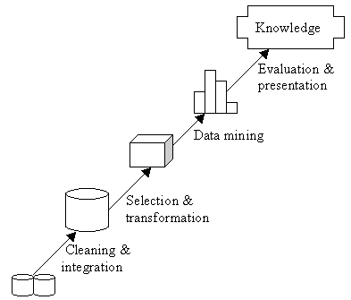
Knowledge Discovery in Database

Slide 9
Basic Concepts of Rough set theory
Let a finite set of objects U and a binary relation R ⊆ U × U be given.
The sets U, R are called the universe and an indiscernibility relation, respectively.
The discernibility relation represents our lack of knowledge about elements of U.
For simplicity, we assume that R is an equivalence relation.
Let X ⊆ U and our goal is to characterize the set X with respect to R

Slide 10
Indiscernibility Relation
By R(x) we denote the equivalence class of R determined by element x.
The indiscernibility relation R describes - in a sense - our lack of knowledge about the universe U.
Equivalence classes of the relation R, called granules, represent an elementary portion of knowledge we are able to perceive due to R.
Using only the indiscernibility relation, information is accessible in form of granules of knowledge.

Slide 11
Information System Framework
In RS data model information is stored in a table
Each row (tuples) represents a fact or an object
Often the facts are not consistent to each other
A data table is called an Information System
Notes:
11

Slide 12
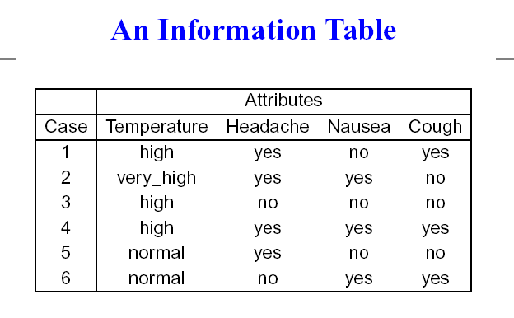
Notes:
12

Slide 13
Represent concepts as information Granules containing objects
RST measures vagueness in terms of boundary region
No prior information is required
RS is a formal approximation of Crisp Set
Handle inconsistency in data by dividing the set into two consistent sets
Notes:
13

Slide 14
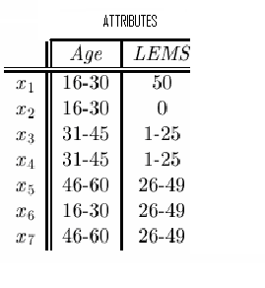
Information Table

Slide 15
Information Function
I = (U, A); an information system
U is a nonempty set of finite objects
A is a nonempty finite set of attributes
A value V_{a} is assigned to each attribute a;
where a ∈ A and v ∈ V_{a}
ρ : U × A → V_{a} an Information function
Notes:
15

Slide 16
ρ (1, Temperature) = high
t = (a, v) an attribute-value pair
[t], is a set of U for which a has value v
[1, 3, 4] = (Temperature, high)
[3, 6] = (Headache, no)
Notes:
16

Slide 17
Information Granules
Concepts are represented as information Granules containing objects.
Let x ∈ U and B ⊆ A
An elementary set of B containing x
[x]_{B} = ∩{[(a, v)]⏐a ∈ B, ρ (x, a) = v} is Information Granules
Elementary Sets of Singletons {a}
[1]_{{Temperature}}= [3]_{{Temperature}}=
[4]_{{Temperature}} : {1, 3, 4}
[5]_{{Temperature}}= [6]_{{Temperature}} : {5, 6}
Notes:
17

Slide 18
Elementary Sets of Subsets of A
[1]_{{Temperature, Headache}} = [4]_{{Temperature, Headache}} =
[(Temperature, high)] ∩ [(Headache, yes)] = {1, 4}
[2]_{{Temperature, Headache}} =
[(Temperature, very_high)] ∩ [(Headache, yes)] = {2}
[3]_{{Temperature, Headache}} =
[(Temperature, high)] ∩ [(Headache, no)] = {3}
[5]_{{Temperature, Headache}} =
[(Temperature, normal)] ∩ [(Headache, yes)] = {5}
[6]_{{Temperature, Headache}} =
[(Temperature, normal)] ∩ [(Headache, no)] = {6}
Notes:
18

Slide 19
Indiscernibility Relation
One representative object for different attribute set, called indiscernible tuples
Two tuples are indiscernible with respect to a set of attributes B ⊆ A; if a(x)=a(x′) ; ∀a ∈ B
IND_{A}(B); the B-indiscernibility relation
{(x, x′)∈U²⏐∀a ∈ B, a(x) = a(x′)}
Notes:
19

Slide 20
IND(Temperature) = {{1,3,4},{2},{5,6}} and
IND(Temperature, Headache) =
{{1,4},{2},{3},{5},{6}}
Notes:
20

Slide 21


Slide 22
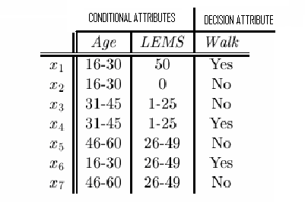
CONCEPT
An elementary set of {Decision} is called a concept
Concepts have the same decision attribute value
{x₁, x₄, x₆}; “Walk” is yes and {x₂, x₃, x₅, x₇}; “Walk” is No
A DECISION TABLE

Slide 23
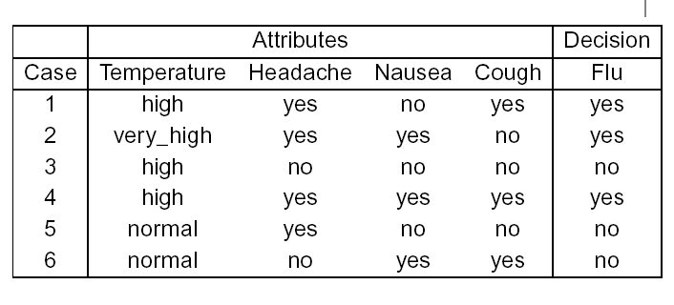

A DECISION TABLE

Slide 24
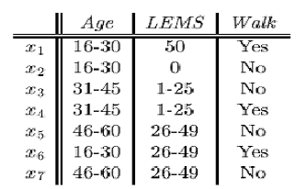
AN INCONSISTENT DECISION TABLE
concept cannot be defined in a crisp manner
Decision attribute “walk” for objects x₃ and x₄
Target set X = {x₃, x₄}cannot be expressed Exactly
Notion of Rough Set emerges

Slide 25
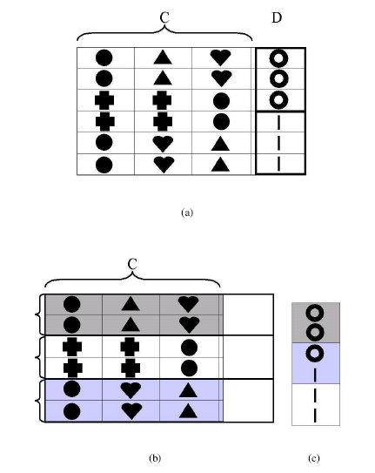
Notes:
25

Slide 26
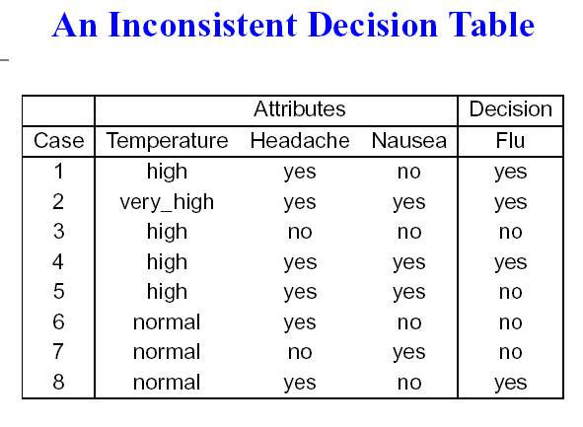
X = {4, 5} cannot be defined exactly, for decision attribute “FLU”

Slide 27
SET APPROXIMATION
X can be approximated by R-lower (RX) and R-upper (RX) approximations
RX={x∈U | [x]_{R} ((R(x)) ⊆ X } and
R X={x∈U | [x]_{R} ((R(x)) ∩ X ≠ ∅}
The lower approximation positively (i.e., unambiguously) classified objects belong to X
The upper approximation possibly classified objects as members of X

Slide 28
ROUGH SET
Objects of R-Boundary Region of X:
RN_{R}(X) = RX – RX, cannot decisively classify into X
Objects of negative region of X: (U – RX),
definitely ruled out as members of X
The set X is Rough (inexact) w.r.t. R if RN_{R}(X) ≠ ∅
RN_{R}(X) = ∅, then the set X is crisp (exact) w.r.t. R
< RX, RX > is called a Rough set

Slide 29
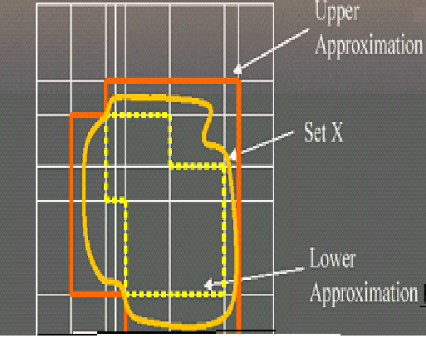
Information Granule
Notes:
29

Slide 30
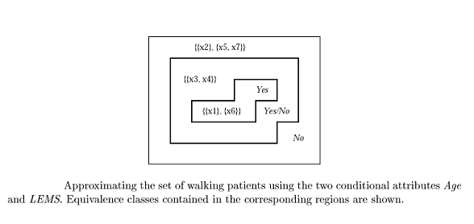
W={x⏐Walk(x)=yes};AW={x₁,x₆};AW={x₁,x₃,x₄,x₆}
Walk is Rough since the Boundary Region is Nonempty

Slide 31
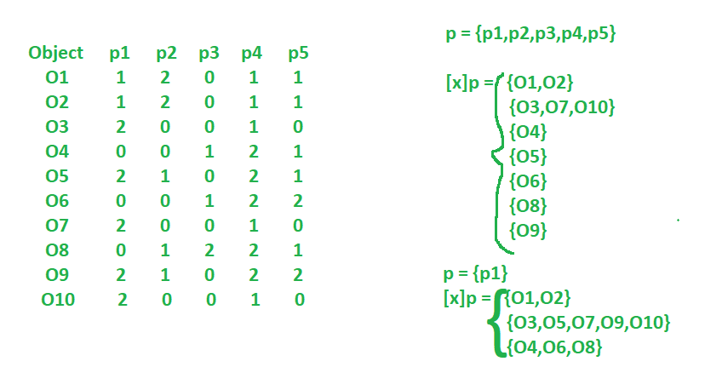
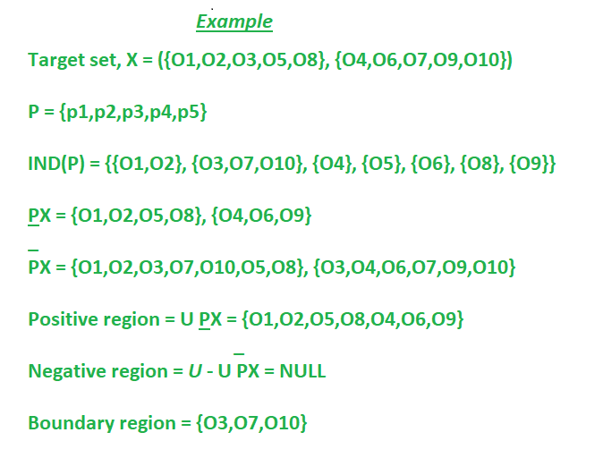
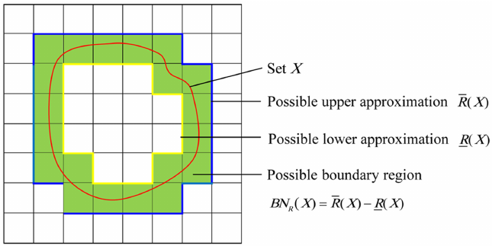

Slide 32
PROPERTIES OF APPROXIMATIONS
B(X) ⊆ X ⊆ B(X)
B(∅) = B(∅) = ∅; B(U) = B(U) = U
B(X∪Y) = B(X) ∪ B(Y)
B(X∩Y) = B(X) ∩ B(Y); B(X∪Y) ⊇ B(X) ∪ B(Y)
B(-X) = -B(X); B(-X) = - B(X); where –X denotes U-X

Slide 33
CATEGORIES OF VAGUENESS
B(X) ≠ ∅ and B(X) ≠ U iff X is roughly B-defineable:
Able to decide for some elements of U belong to X or –X, using B
B(X)=∅ and B(X)≠U iff X is internally B-indefineable
Able to decide for some elements of U belong to -X but unable to decide for any element of U, whether it belongs to X or not, using B

Slide 34
B(X) ≠ ∅ and B(X)=U, iff X is externally B-defineable
Able to decide for some elements of U belong to X but unable to decide for any element of U, whether it belongs to -X or not, using B
B(X)=∅ and B(X) = U iff X is totally B-indefineable
Unable to decide for any element of U belong to X or –X, using B

Slide 35
IND(Temperature, Headache, Nausea) = {{1},{2},{3},{4,5},{6,8},{7}}
IND(Flu) = {Yes}, {No} = {{1, 2, 4, 8}, {3, 5, 6,7 }}
A{1, 2, 4, 8} = {1, 2}≠∅
A{3, 5, 6, 7} = {3, 7}≠∅
A{1,2,4,8} = {1,2,4,5,6,8} ≠ U
A{3,5,6,7}={3, 4, 5, 6, 7, 8}≠U
So concept “flu” is roughly B-defineable
Notes:
35

Slide 36
Rules induced from the Lower Approximation of the concept are called certain
(Temperature, high) & (Headache, yes) & (Nausea, no) → (Flu, yes)
(Temperature, high) & (Headache, no) & (Nausea, no) → (Flu, no)
Notes:
36

Slide 37
ACCURACY MEASUREMENT
RS can be characterized numerically by measuring accuracy of approximation of the target set: α_{B}(X) = ⏐BX ⏐ / ⏐BX ⏐; 0 ≤ α_{B}(X) ≤ 1
α_{B}(X)=1, the upper and lower approximations are equal and X is crisp w.r.t. B (X is precise)
α_{B}(X) < 1, X is Rough w.r.t. B (X is vague)
If lower approximation is empty, the accuracy is zero
Notes:
37

Slide 38
ROUGH SET and MEMBERSHIP FUNCTION
| X ∩ B(x) |
μ_{X}^{B}(x) = ; μ_{X}^{B}(x) ∈ [0, 1]
| B(x) |
Interpreted as a degree of certainty to which x belongs to X
B( X)={x∈U: μ_{X}^{B}(x) = 1}, B(X)={x∈U: μ_{X}^{B}(x) > 1}
BN_{B}(X) = {x ∈ U: 0 <μ_{X}^{B}(x) < 1},

Slide 39
PROPERTIES of ROUGH MEMBERSHIP FUNCTION
μ_{X}^{B}(x) = 0 iff x∈- B(X)
μ^{B}_{X∪Y} (x) ≥ max (μ_{X}^{B}(x), μ_{Y}^{B}(x)) for any x∈U
μ^{B}_{X∩Y} (x) ≤ min (μ_{X}^{B}(x), μ_{Y}^{B}(x)) for any x∈U
Difference between fuzzy and rough membership

Slide 40
Rough membership can be regarded as a generalization of fuzzy membership
Connection between vagueness and uncertainty
Vagueness is related to sets
Uncertainty is related to elements of sets
Rough set approach shows connection between these two concepts

Slide 41
REDUCT and CORE
A subset of attributes can fully characterize the knowledge in the database, is called a Reduct
[x]_{RED} = [x]_{A} ; the equivalence classes induced by RED attribute set is same that of full attribute set A
Attribute a is dispensible, if IND(A-{a}) = IND(A); otherwise a is indispensible
Notes:
41

Slide 42
No attribute can be removed from set RED without changing the equivalence classes [x]_{A}
The reduct of an information system is not unique
Finding a minimal reduct is NP hard problem
The set of attributes common to all reducts is called the core
Notes:
42

Slide 43

subset B of the attribute set A is a Reduct if and only if
IND(B) = IND(A) and IND(B-{a}) ≠ IND(A) for all a ∈ B
IND(A) = {{1},{2},{3},{4},{5},{6}}
IND(Temperature) =
{{1,3,4},{2},{5,6}} ≠ IND(A)
IND(Temperature, Headache)=
{{1,4},{2},{3},{5},{6}}≠IND(A)
{Temperature}, {Temperature, Headache} are not Reducts
Notes:
43

Slide 44
IND(Temperature, Headache, Nausea) = IND(A),
IND(Temperature, Nausea, Cough) = IND(A),
IND(Headache, Nausea, Cough) = IND(A)
Therefore, Reducts are:
{Temperature, Headache, Nausea},
{Temperature, Nausea, Cough} and
{Headache, Nausea, Cough}
Notes:
44

Slide 45
FEATURE SELECTION
Evaluate all Reducts and take intersection of them i.e. core
Keep only the Reducts which appear sufficiently often, called approximate Reducts
Distinguish between useless and useful attributes
In reality every attribute is more or less useful, therefore, quantify the attributes
Notes:
45

Slide 46
Evaluate how much decision attributes depend on condition ones
Remove one attribute and evaluate again the dependency
The more important the attribute is, more the dependency value decreases
Difference of dependency, determines utility of the attributes

Slide 47
ATTRIBUTE DEPENDENCY
What degree of dependency exist between two (disjoint) sets of attributes, B (conditional) and D (decision)?
The dependency is defined:
Σ_{X∈INDD(U)}|BX| | POS_{B}(D) |
γ(B,D) = =
|U| |U|
Notes:
47

Slide 48
If γ(B,D) = 1, implies the attributes in B can precisely define the partition IND_{D}(U)
If BX= ϕ, γ(B,D) = 0.
If γ(B,D)<1, then D depends on B by a degree γ(B,D); (0≤ γ(B,D) ≤1)

Slide 49
Compute how much removing an attribute changes the original dependency:
γ(B,D) - γ(B-{a}, D)
σ_{B,D} (a) =
γ(B,D)
If γ(B,D) = γ(B-{a}, D) and σ_{B,D}(a) = 0
Then (B-{a}) is a reduct
The attribute a is not significant at all and so we don’t consider it as a useful attribute.
Notes:
49

Slide 50
If B is a reduct, some of its attributes are less useful than others, because they allow to distinguish between a few small cases
A Reduct is transformed into a decision rule
(B ⇒_{k} D);
Input attributes is used to derive specific knowledge of the output

Slide 51
Dimension Reduction
The aim of dimension reduction is to find a minimum set of relevant attributes that preserves all the essential information of the system sufficient for decision-making.
This minimum set of attributes called reduct is used instead of the entire attribute set for classification of data.
Let the decision system DS = (U, A, C, D), where U is the universe of discourse and A is the total number of attributes (such that A= C∪D);
C is the number of conditional attributes and D is the decision attributes.

Slide 52
CLASSIFICATION
Notes:
52

Slide 53
Classification is the original goal of RST
Information table is Consistent or Inconsistent
Calculate the Reducts of the table and extract the Rule
If (Temperature is HIGH) And (Headache is YES) and (Nausea is NO) Then (Disease is Flu)
Notes:
53

Slide 54
THE DISCERNIBILITY MATRIX
Discernibility matrix of A, a symmetric matrix:
c_{ij} = {a∈A|a(x_{i}) ≠ a(x_{j})}; for i, j = 1…n
A discernibility function f_{I} for I is a Boolean function of m variables a*₁, a*₂, … a*_{m} :
f_{I} (a*₁, a*₂, … a*_{m} ) = ∧{∨c*_{ij} |1≤j ≤i ≤n, c_{ij} ≠ ϕ
Where c*_{ij} = {a* |a∈ c_{ij} }

Slide 55
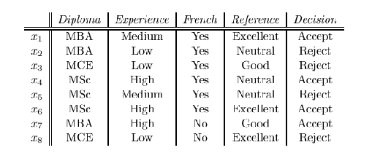
I = (U, {Diploma, Experience, French, Reference}) I′ = (U, I ∪ {Decision})
g_{I}(d, e, f, r) = (e∨r)(d∨e∨r)(d∨e∨r)(d∨r)(d∨e)(e∨f∨r)(d∨e∨f)
(d∨r)(d∨e)(d∨e)(d∨e∨r)(e∨f∨r)(d∨f∨r)
(d∨e∨r)(d∨e∨r)(d∨e∨r)(d∨e∨f)(f∨r)
(e)(r)(d∨f∨r)(d∨e∨f∨r)
(e∨r)(d∨e∨f∨r)(d∨e∨f∨r)
(d∨f∨r) )(d∨e∨f)
(d∨e∨r)
After simplification the function g_{I} (d, e, f, r ) = e ∧ r

Slide 56
RULE EXTRACTION
Find the minimal set of consistent rules that characterize the system
For a set of condition attributes {A₁, A₂, …, A_{n}} and a decision attribute Q, the rules should have the form
(A_{i}=a) ∧ (A_{j}=b) ∧ …….. ∧ (A_{k}=c) → (Q=d)
This is typical form of Association Rule
Notes:
56

Slide 57
MULTIPLE CLASSIFIER
Three classes of knowledge in an Information System:-
Indispensable knowledge in core; useful but not necessary attributes constitute the reduct together with core and others are irrelevant
Existence of multiple reducts represent the Information system in alternative ways
Notes:
57

Slide 58
Rough set approaches yield subspaces of classification
In practices multiple kinds of classifiers to obtain the diversity of decisions from different classifiers
Ensemble of Classifiers
A multiple classifier system, lead to improvement of classification in terms of both accuracy and stability

Slide 59
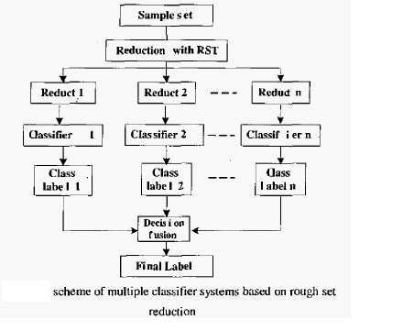
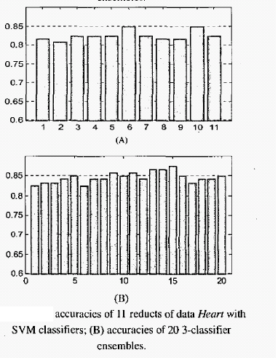
Notes:
59

Slide 60
APPLICATIONS
Dimensionality Reduction
FEATURE SELECTION
Discernibility function based and attribute dependency based
Rough set theory for Classification
E-MAILS CLASSIFICATION
Rough set based model classify the emails into three categories - non-spam, spam and suspicious
positive region, negative region and boundary region, respectively
classification reduce the error rate so that a non-spam is classified as a spam.
Notes:
60

Slide 61
CONCLUSIONS
The Rough Set theory is a viable approach for extraction of meaningful knowledge and making predictions for an individual data object, rather than a population of objects
Combining Rough Set Theory and Fuzzy set Theory together serve both theoretical and practical purpose for handling uncertainty
Notes:
61

Slide 62
Thank you

